Slide 1
Implementing PCA
with a
Neural Network
Presenters
Reza Abdollahi apa6323@psu.edu
Ali Iranmanesh afi5220@psu.edu
Ava Iranmanesh ami5520@psu.edu
Joshua Nallaraja jmn6092@psu.edu
Supervisor
Professor Jonathan Liaw
Course
CMPSC 445
Group 1

Slide 2
Goal, Challenge, Solution
Objectives
  Explore how Neural Networks (Autoencoders) can be used to perform PCA.
  Compare the latent space learned by the neural network with that obtained from PCA by computing their principal angles.
  Examine the advantages of using neural networks for dimensionality reduction on real-world datasets.
Unsupervised

Slide 3
Goal, Challenge, Solution
Problem
  High-dimensional data can be difficult to analyze and visualize efficiently.
  PCA which would be computationally expensive.
  PCA is a standalone, non-trainable method.
Our solution
  A Neural Network (Specifically autoencoders) as a replacement to PCA
    Unlike PCA, a NN with a non-linear activation function will not assume the linearity of a dataset.
    A Linear Autoencoder can be trained with gradient descent and integrated into deep learning pipelines, making it scalable and compatible with neural network architectures.
    Linear AE can be trained using stochastic gradient descent on mini-batches, scalable to massive datasets much easier, and less expensive.

Slide 4
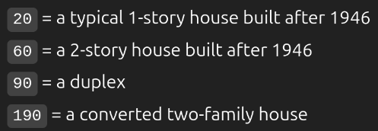

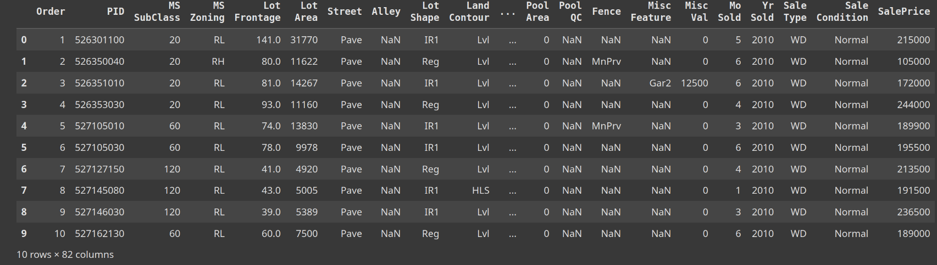
Data Source(s)
AmesHousing Dataset (Primary)
High dimensionality = Curse of dimensionality
Describes the various characteristics of residential homes in Ames, Iowa such as MS SubClass, LotShape.
Contains 2,930 entries with 82-columns (79 features).
Publicly available at Kaggle‘s Ames Housing Competition page
https://www.kaggle.com/competitions/stat101ahouseprice

Slide 5
Plan
  Data Preparation
2. Basic PCA Implementation
  Cleaning dataset to handle missing values and outliers with houses.
  Normalize numerical features to prevent unneeded bias.
  Categorical features transformed into 1-hot feature vectors.
  With the use of Scikit-learn, reduce dimensionality of dataset using traditional PCA.
  Analyze the explained variance of each principle components.
  Visualize results

Slide 6
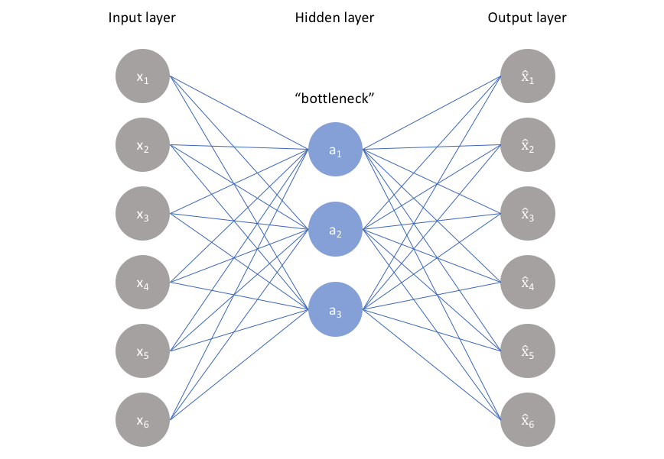
Plan Cont.
3. Autoencoder Implementation
4. Evaluation – Final States
  Build and train a linear autoencoder using PyTorch.
  Compare various factors:
    Reconstruction error
    Principle Angle
    Performance in a regression task
  Determine the effectiveness of a neural network-based PCA vs Traditional.

Slide 7
Knowledge Areas and Tools and Libraries
Knowledge Areas
Tools and Libraries
  Linear Algebra
  Neural Networks(Autoencoders)
  Data Analysis.
  Data Visualization.
  Test and Validation metrics.
  Python
  PyTorch (for training neural networks)
  SciKit-learn for implementation of traditional PCA
  Pandas, Numpy, MatPlotLib, and Seaborn for data visualization and storage

Slide 8
Techniques
  Dimensionality reduction
  Autoencoder architecture design
  Feature scaling
  Model Evaluation

Slide 9
Team Member Roles and Communication
Mode of communication
Version control: Git
Project repository: google drive
Communication: Teams, Zoom, Outlook
Meeting for 2 hours a week at variable times.
Joshua: Python programming and development.
Reza: Data preparation and preprocessing.
Ali: Machine Learning and test implementations.
Ava: Data visualization

Slide 10
Questions?

